Slide 1
EN 410 Energy Management
Gurubalan Annadurai
guru.a@iitb.ac.in

Slide 2
Strategies of Net Zero Buildings - Space Cooling
Reduce the room load
Reduce the system load
Meet the load by passive cooling methods

Slide 3
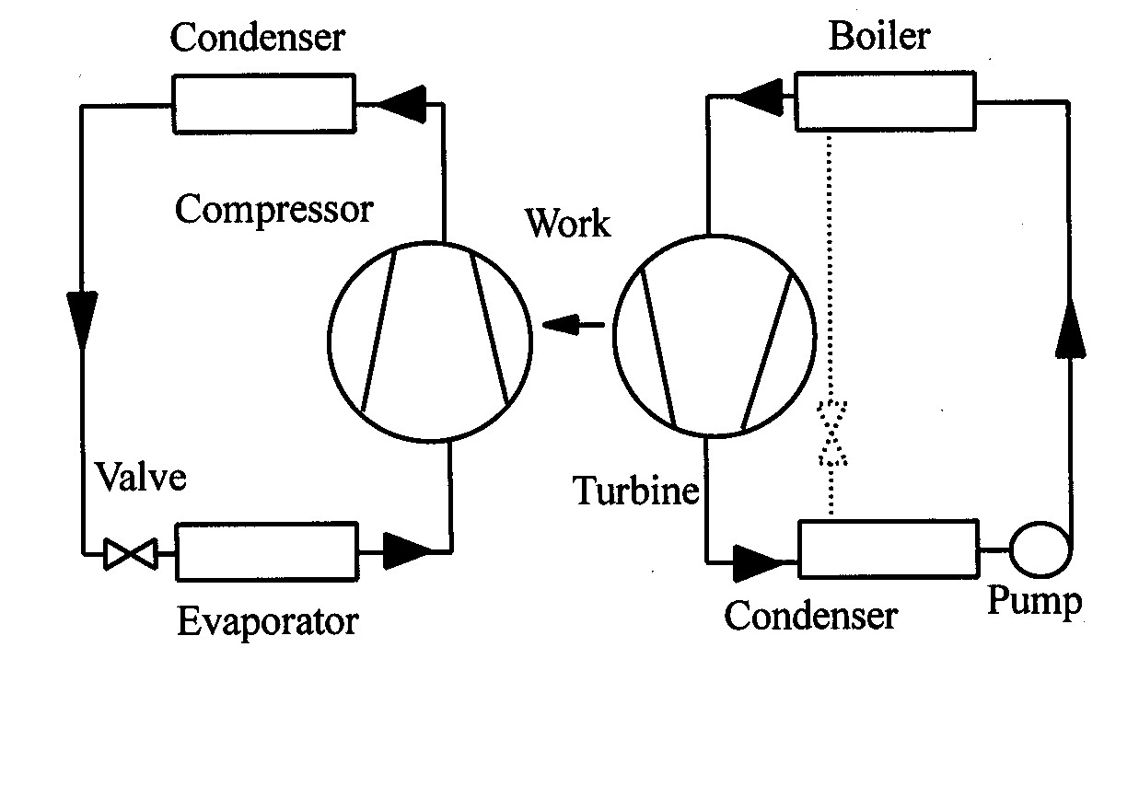
Vapor absorption system
Passive cooling
Working Pairs:
LiBr – H₂O ,
NH₃ – H₂O,
R134a - DMAC
Heat Exchanger
VCRS
Thermal
Power
Plant
Absorber
Thermal Compression

Slide 4
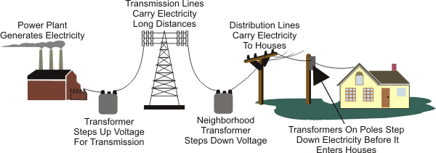
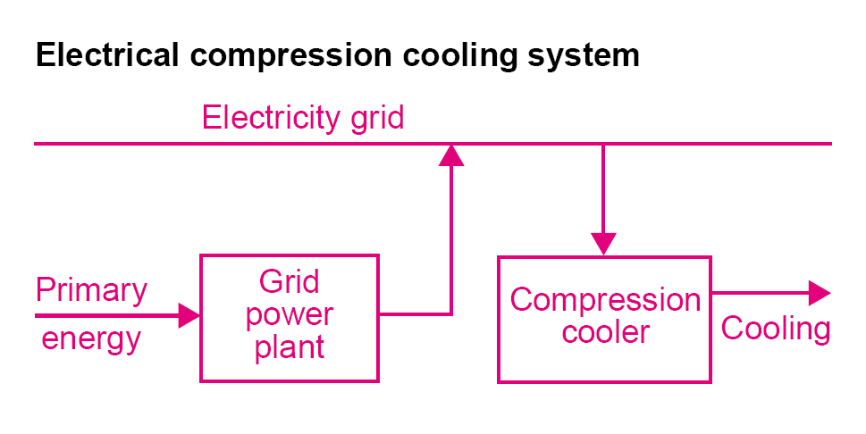

Vapor absorption system
Passive cooling
Power generation – Transmission – Compression Cooling
Expected losses in power lines
Power plant loss : 70%
(Efficiency = 30%)
Generator Loss : 5%
T &D Loss : 30%
End Equipment loss : 10%
25 kW – 7.5 kW – 6.75 kW – 4.75 kW – 4.25 kW
Heat Source to Site Power Factor: 4.25/25 = 0.17

Slide 5
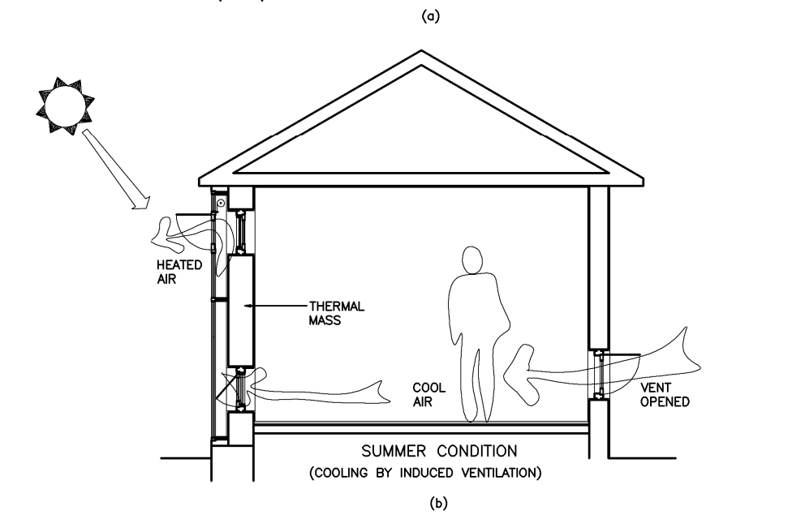
Ventilation cooling
Trombe wall / Solar chimney

Slide 6
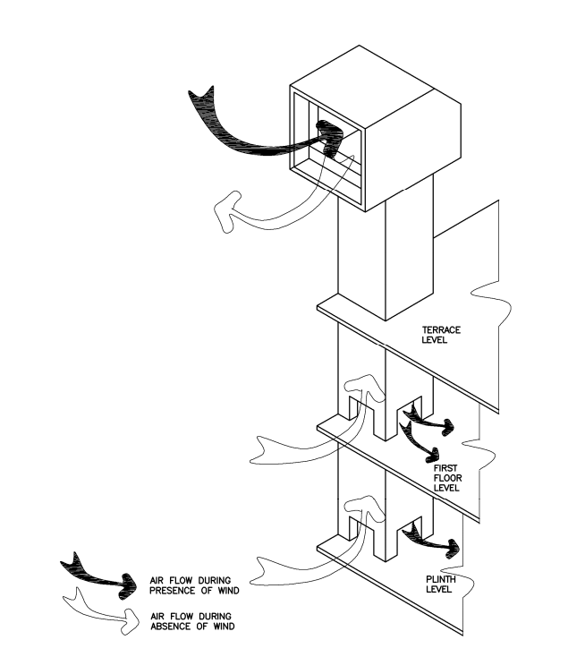
Wind tower
Ventilation cooling

Slide 7
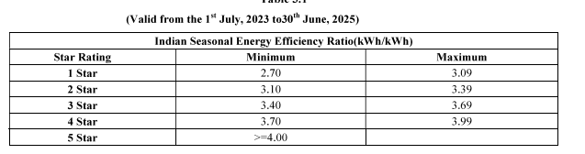
Estimate the energy demand (EER) of an air-conditioner
Inlet condition: DBT=20℃, WBT=14℃
Outlet condition: DBT=12.7℃, WBT=11.3℃
Capacity = 20 TR
Air velocity = 2.5 m/s
Cross sectional area = 1.2 m²
Power drawn by compressor = 10.69 kW

Slide 8
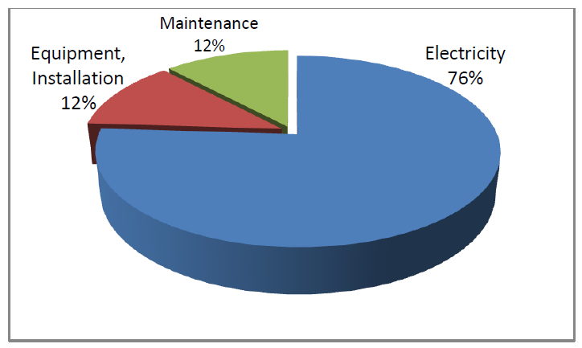
Compressor
A compressor is capable of compressing the gas to very high pressures.
Commonly used in industrial facilities to perform a wide variety of tasks such as cleaning, operating pneumatic equipment, and even refrigeration.
It is often referred to as the fourth utility after electricity, water, and natural gas or oil.
Compressors are responsible for most energy consumption in many facilities.
The electricity consumption associated with compressors and compressed air systems may represent 70% of total consumption
Refrigerant or Air Compressor
A typical distribution of costs associated with compressors

Slide 9
Classification
Compressors are broadly classified as positive displacement (or displacement) and dynamic compressors.
In positive displacement compressors, an application of shaft work decreases the volume of the fluid chamber, thus compressing it.
In dynamic compressors, an application of external work allows the transfer of angular momentum to the fluid, and this result in an increase in fluid pressure.
Positive displacement compressor: reciprocating and rotary.
Rotary compressor: vane, screw, roots, and liquid ring.
Reciprocating compressor: trunk, crosshead, free piston, labyrinth, and diaphragm.
Dynamic compressor: radial or centrifugal, axial, and ejector.
Classification according to lubricant/non-lubricant, Water/air cooled, Single/Multi Cylinder, Single/Multi stage

Slide 10
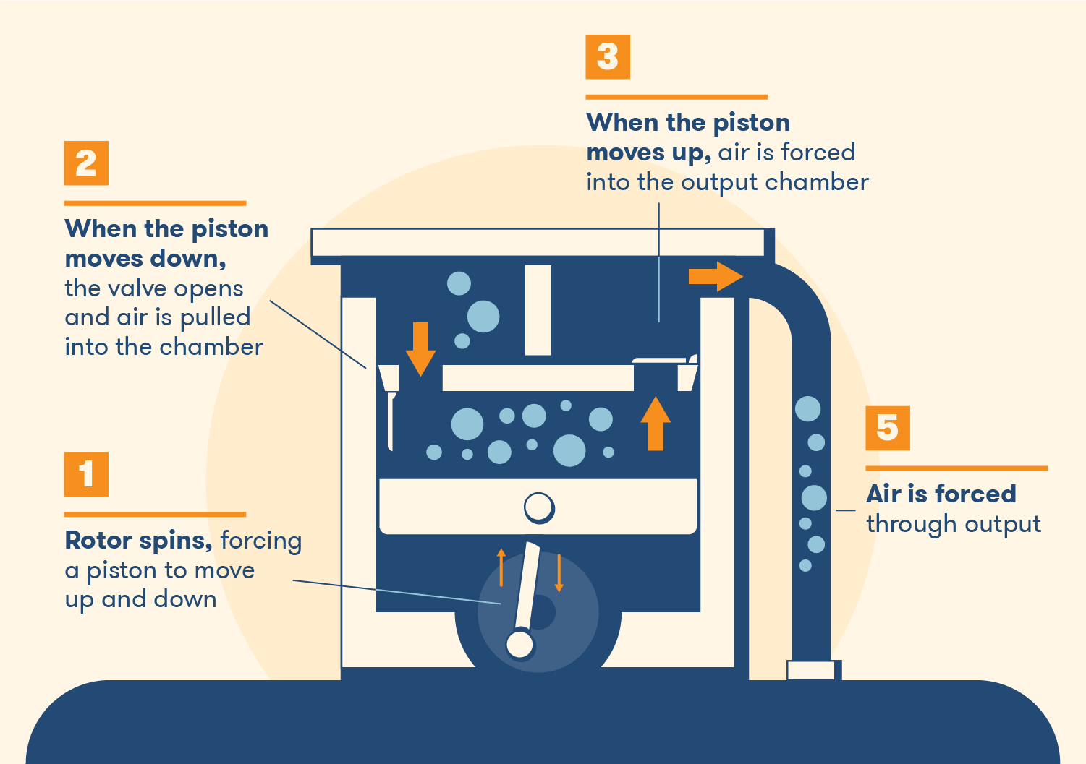
Reciprocating compressor

Slide 11
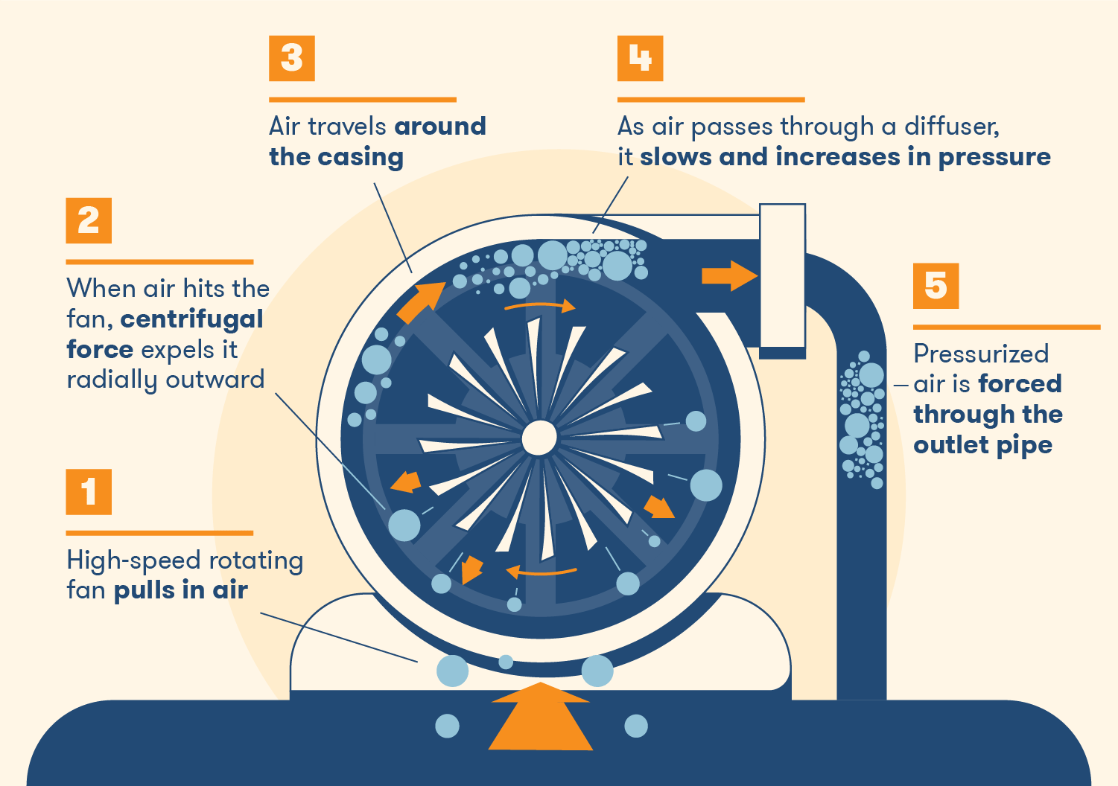
Centrifugal compressor

Slide 12
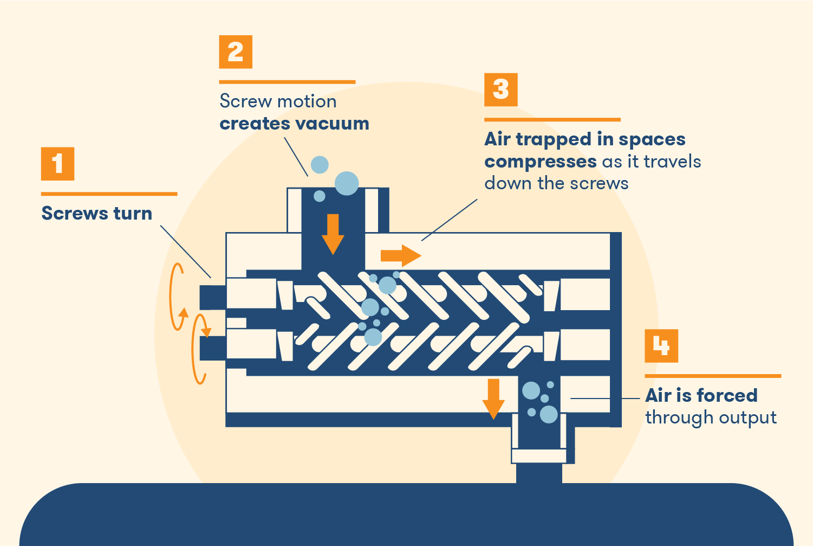
Screw compressor

Slide 13
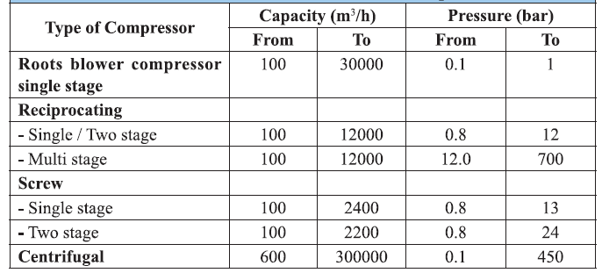
Selection of Compressor

Slide 14
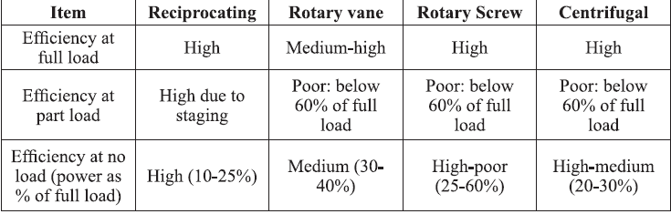
Comparison of Compressors

Slide 15
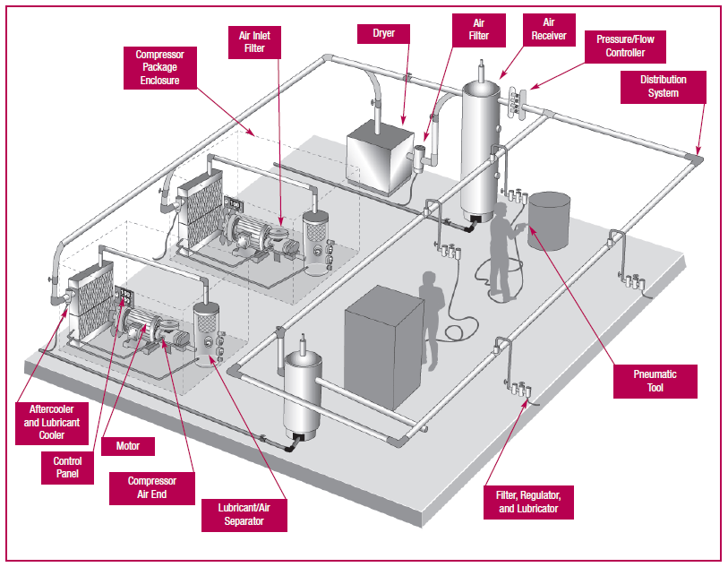
Compressor air system

Slide 16
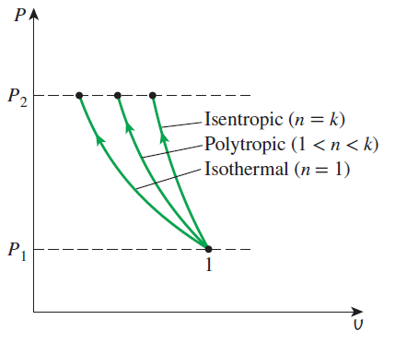
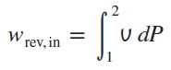
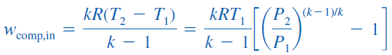
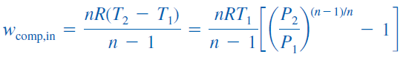
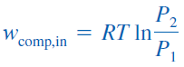
Compressor work
Isentropic (Pv^{k} = constant):
Polytropic (Pv^{n} = constant):
Isothermal (Pv = constant):
The adiabatic compression (Pv^{k} = constant) requires the maximum work and the isothermal compression (T = constant) requires the minimum.

Slide 17
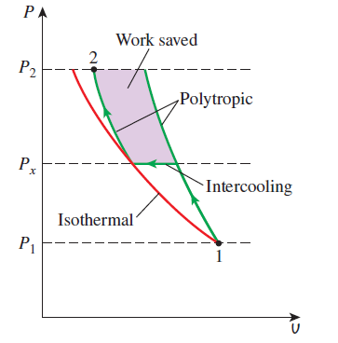
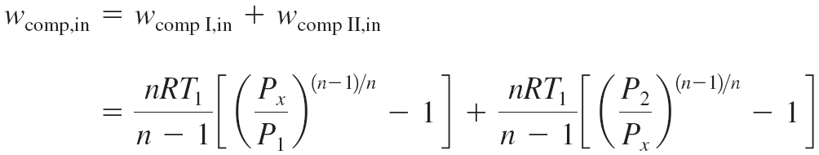
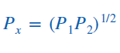
Multistage Compression with Intercooling
The gas is compressed in stages and cooled between each stage by passing it through a heat exchanger called an intercooler.
To minimize compression work during two-stage compression, the pressure ratio across each stage of the compressor must be the same.

Slide 18
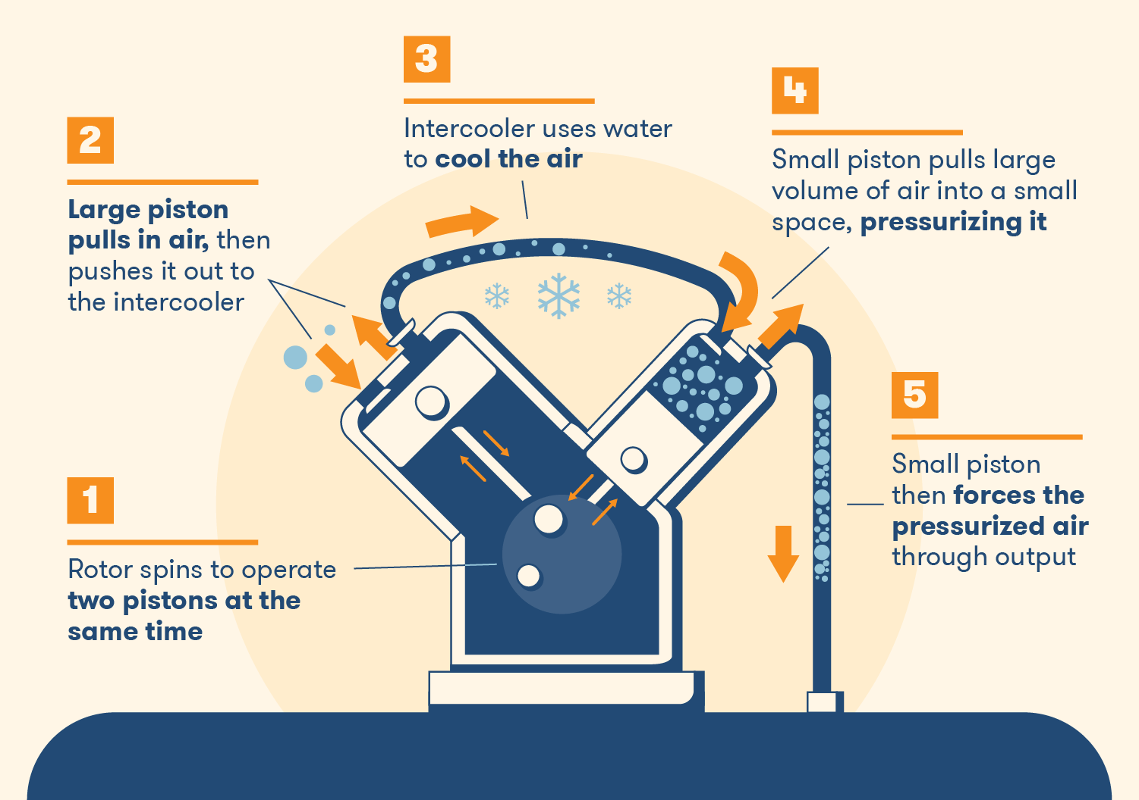
Multistage Compression with Intercooling

Slide 19
Multistage Compression
Air is compressed steadily by a reversible compressor from an inlet state of 100 kPa and 300 K to an exit pressure of 900 kPa. Determine the compressor work per unit mass for (a) isentropic compression with k = 1.4, (b) polytropic compression with n = 1.3, (c) isothermal compression, and (d) ideal two-stage compression with intercooling with a polytropic exponent of 1.3.
Isentropic (Pv^{k} = constant):
Polytropic (Pv^{n} = constant):
Isothermal (Pv = constant):

Slide 20
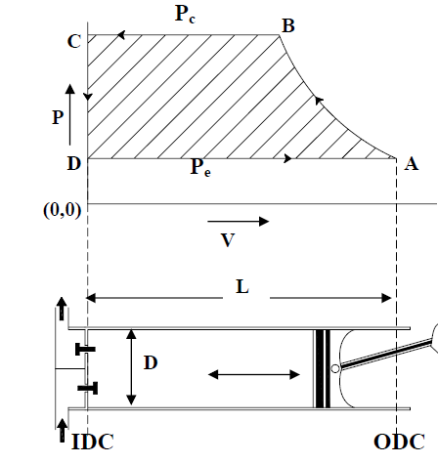
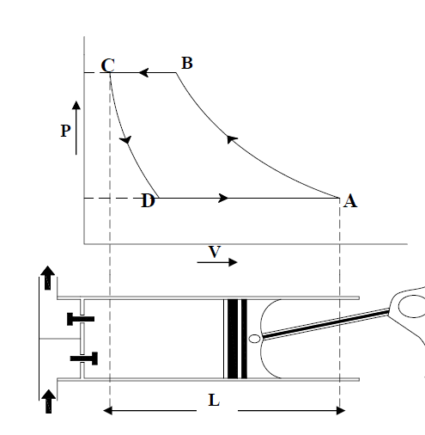
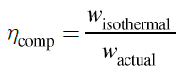
Compressor Performance

Slide 21
Efficient Operation of Compressor
Cool air intake – Compressor room always at a high temp – Every 4°C drop – 1% reduction in power – Fresh cool intake with less pressure drop
Dust free intake – need of high eff filter, maintenance - Every 250 mm WC pressure drop due to choked filter increase the power consumption by 2%
Dry air intake – moisture not suitable for pneumatics
Location of compressor – Accessibility of clean, cold and dry air
Adequate intercooler – approach the isothermal compression
Adequate after-cooler – A high temp. and humid air enters the receiver which may lead to condensation – corrosion, pressure drop and leakage in pipe lines
Reduced delivery pressure if possible – lesser the pressure ratio – lesser the power requirement

Slide 22
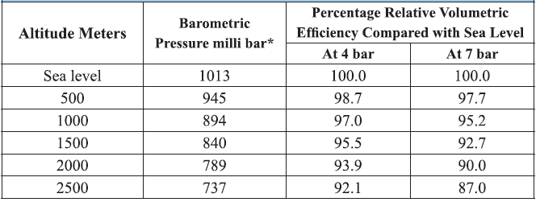
Efficient Operation of Compressor
Segregate the low and high pressure requirements – don’t use reducing valves if possible
Minimum pressure drop in the air lines – 0.3 bar in the main line – 0.5 bar in the distribution line
Avoid misuse of compressed air – like body or floor cleaning – use blower air instead
Elevation – higher the altitude and higher the power

Slide 23
Avoid air leakage
Manufacturers are quick to identify energy (and thus money) losses from hot surfaces and to insulate those surfaces.
Not so sensitive to save compressed air since they view air as being free
Attention is when the air and pressure losses interfere with the normal operation of the plant.
Several studies at plants have revealed that up to 40% of the compressed air is lost through leaks.
Eliminating the air leaks totally is impractical, and a leakage rate of 10% is considered acceptable.
Air leak locations: Joints, flange connections, elbows, reducing bushes, sudden expansions, valve systems, filters, hoses, check valves, relief valves, extensions, and the equipment connected to the compressed-air lines.

Slide 24
Detecting air leaks
Perhaps the simplest way of detecting a large air leak is to listen for it.
The high velocity of the air escaping the line produces a hissing sound that is difficult not to notice except in environments with a high noise level.
Another way of detecting air leaks, especially small ones, is to test the suspected area with soap water and to watch for soap bubbles.
This method is obviously not practical for a large system with many connections.
A modern way of checking for air leaks is to use an acoustic leak detector, which consists of a directional microphone, amplifiers, audio filters, and digital indicators.
Pressure drop test

Slide 25
Capacity control
ON/OFF control – using pressure switches – suitable for small compressors
Load/Unload – Compressors may consume power even at unload conditions
Multi-step control – High capacity compressor – 100, 75, 50 and 25%
Vane / Speed control – Centrifugal type

Slide 26
References
https://www.trane.com/content/dam/Trane/Commercial/global/products-systems/education-training/engineers-newsletters/airside-design/admapn020en-0406.pdf
https://nzeb.in/knowledge-centre/hvac-2/radiant-cooling-systems/
NPTEL, Mechanical Engineering - Refrigeration and Air Conditioning
https://archive.nptel.ac.in/courses/112/105/112105129/
Karthik Panchabikesan, Kumaresan Vellaisamy, Velraj Ramalingam, Passive cooling potential in buildings under various climatic conditions in India, Renewable and Sustainable Energy Reviews, Volume 78, 2017, Pages 1236-1252,
https://climate.earthathome.org/sunlight-stored-in-soil/
https://fairconditioning.org/knowledge/passive-design/shading/
https://www.sciencedirect.com/science/article/pii/S1364032116002665#f0010
https://www.bigrentz.com/blog/how-air-compressors-work

